Slide 1
Superstore Finance Dashboard
Sales & Profit Analysis Using Power BI
Notes:
Salkapuram Chaitanya | 21-11-26| Internship Task 4

Slide 2
Objective
Analyze sales, profit, and order trends
Build an interactive dashboard for business stakeholders
Enable insights using KPIs, maps, time-series, and slicers
Support decision-making with drilldown and filters

Slide 3
Dataset Overview
Dataset Name: Global Superstore Dataset (Kaggle)
Total Records: 51,000+
Columns: Sales, Profit, Orders, Segment, Category, Region, Ship Mode, Date, Geography
Time Period: 2011–2014Add small screenshot of the raw data.

Slide 4
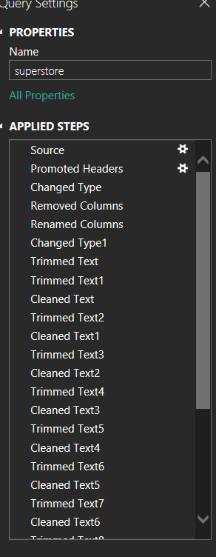
Data Cleaning Steps
Data Cleaning Steps
Removed corrupted column
Changed data types (Date, Number, Text)
Created Year, Month, Quarter fields
Trimmed & cleaned text columns
Replaced null values
Removed duplicates
Ensured correct geography mapping
Created Date table

Slide 5

Measures (DAX)
Total Sales
Total Profit
Profit Margin %
Total Orders
Year-over-Year & Month-over-Month Growth
Shipping Cost measure

Slide 6
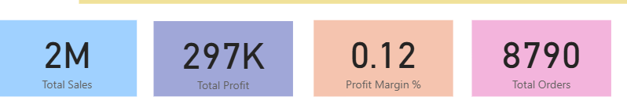
KPIs Used
Total Sales
Total Profit
Profit Margin %
Total Orders

Slide 7
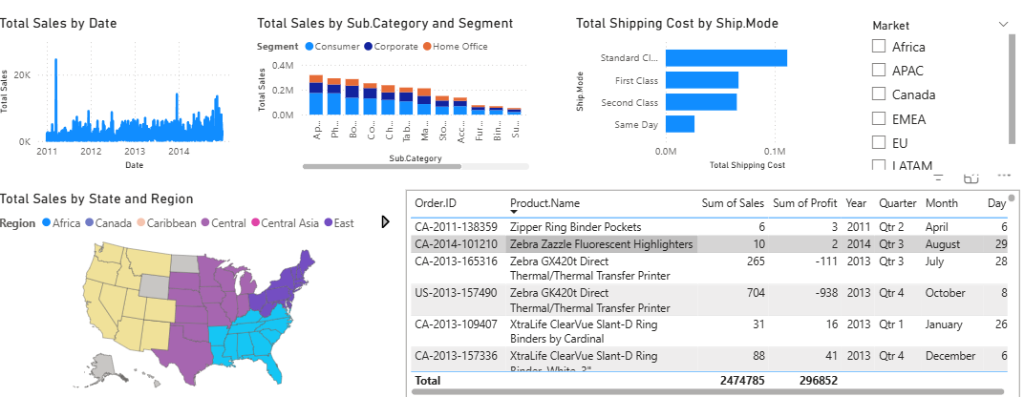
Visuals in Dashboard
Line Chart → Sales by Date
Bar Chart → Subcategory vs Sales/Profit
Clustered Bar → Shipping Cost by Ship Mode
Shape Map → Sales by State & Region
Table → Order-Level Details
Slicers → Year, Category, Segment, Market, Ship Mode

Slide 8
Insights & Findings
Sales increased steadily from 2011 to 2014.
2. Technology category generated highest sales.
3. Some SubCategories like Tables show high sales but low profit.
4. Standard Class is the most used Ship Mode.
5. Western and Eastern regions contribute maximum sales.
6. Profit margin overall remains around 12%.
7. Corporate Segment spends the most

Slide 9
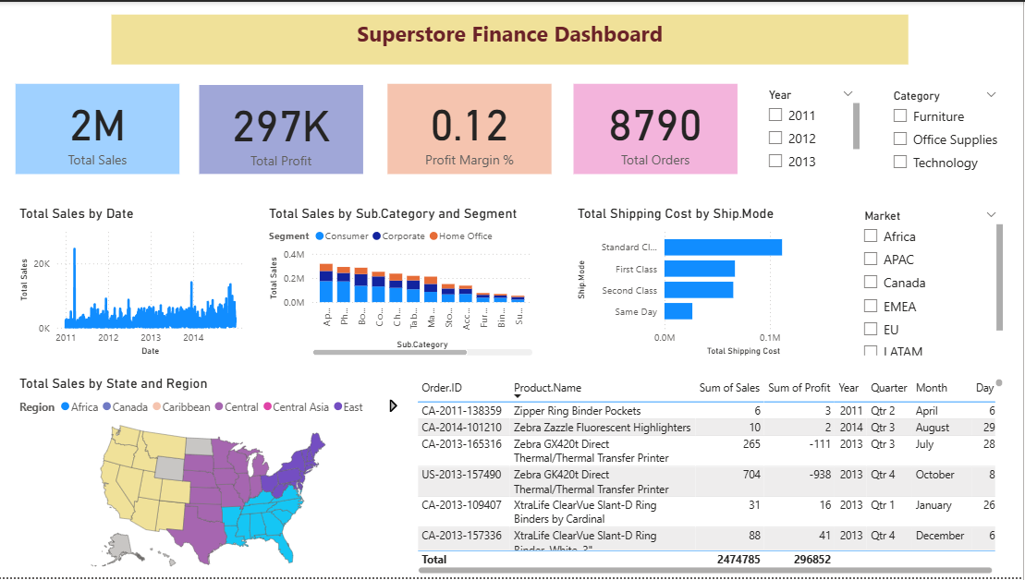
Dashboard Screenshot (Full View)

Slide 10
Conclusion
The dashboard helps track sales, profit, and orders effectively.
Slicers make the report interactive for stakeholders.
Trend analysis helps in forecasting.
Useful for business strategy and decision-making.

Slide 11
Thank You

